Slide 1
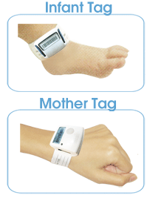
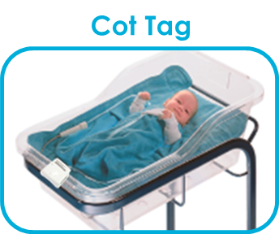
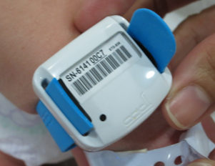
Key objectives of the system
Mother Tag
Auto match infant to the right mother
Auto match infant to the right cot bed
Prevent infant abduction
Infant Tag
CADI SCIENTIFIC
CONFIDENTIAL
1
Notes:
The key objective of the system
Make sure the right infant is brought to right mother
Make sure the right infant is put back into the right cot
To prevent infant abduction

Slide 2
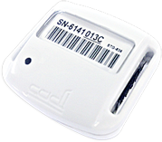

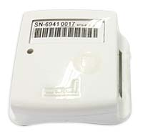
Peace of mind for new parents
Automatic tag verification
20 - 30cm
Notes:
Using CADI’s patented tag-to-tag wireless technology, tags that come close, about 20-30cm, will perform automatic verification. This can be done without dependency of any access points or receiver infrastructure. Works even during system downtime!

Slide 3
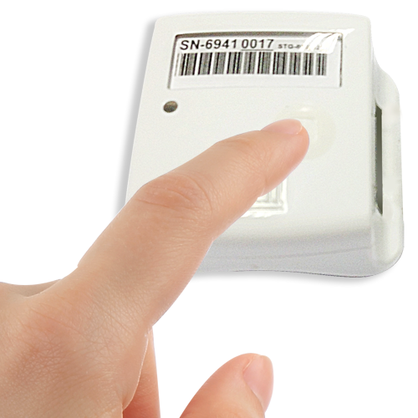
Enhance Patient Experience
On-demand verification
CADI SCIENTIFICx
CONFIDENTIAL
3
Notes:
To enhance patient experience,

Slide 4
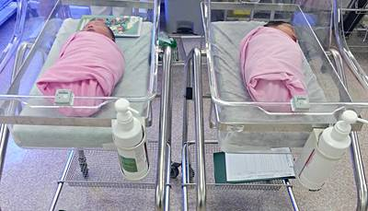
Saves Nurses’ Time
Unique RFID cot tag
Notes:
CADI’s world-first automatic baby-to-bassinet matching feature saves nurses’ time unwrapping and wrapping up the baby to manually check that the right baby has been put into the right
while giving mothers complete peace of mind.

Slide 5
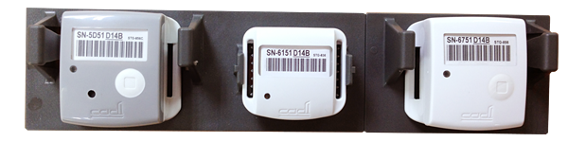
Saves Nurses’ Time
Tags are pre-paired & re-usable
No pairing process is needed!
Notes:
CADI’s tags are prepaired and reusable.
Being pre-paired means that a unique ID is hardcoded electronically into the chip of the tag.
That helps to speed up registration for nurses as No pairing process is needed!
more importantly, it prevents accidental wrong pairing of two physical tags, making usage fool-proof for busy nurses.

Slide 6
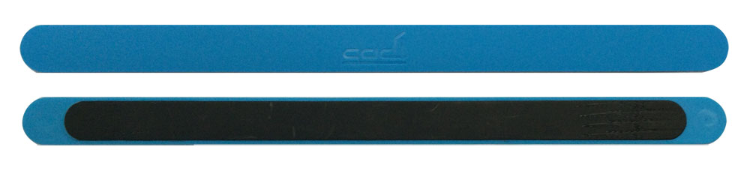
Soft & comfortable strap for infants
Tamper Alert Straps

Slide 7
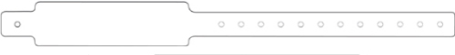

Simple Tagging Process
Strap on the tag on the mother’s wrist using patient wristband
Infant Tag
Strap on the tag on the infant’s ankle using infant strap
Snap on the tag on the cot bracket

Slide 8
Auto matching and monitoring on Mother & Cot Tags
Infant Tag
30 cm
Sound
Melody or alert
Infant Tag
LED Light
Green
or Red
20 cm
CADI SCIENTIFIC
CONFIDENTIAL
8

Slide 9
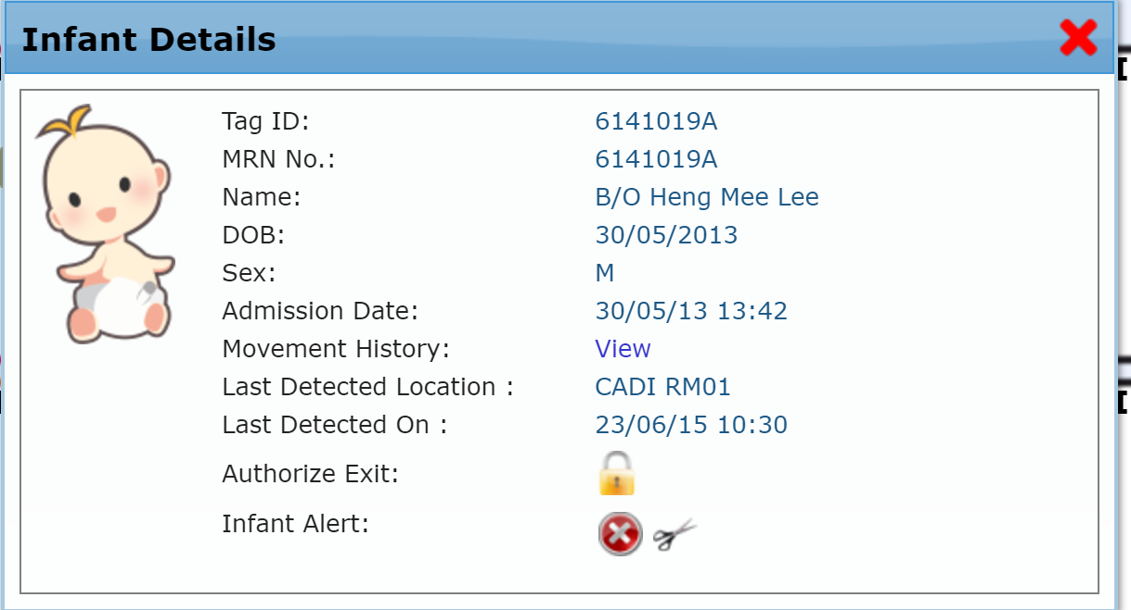
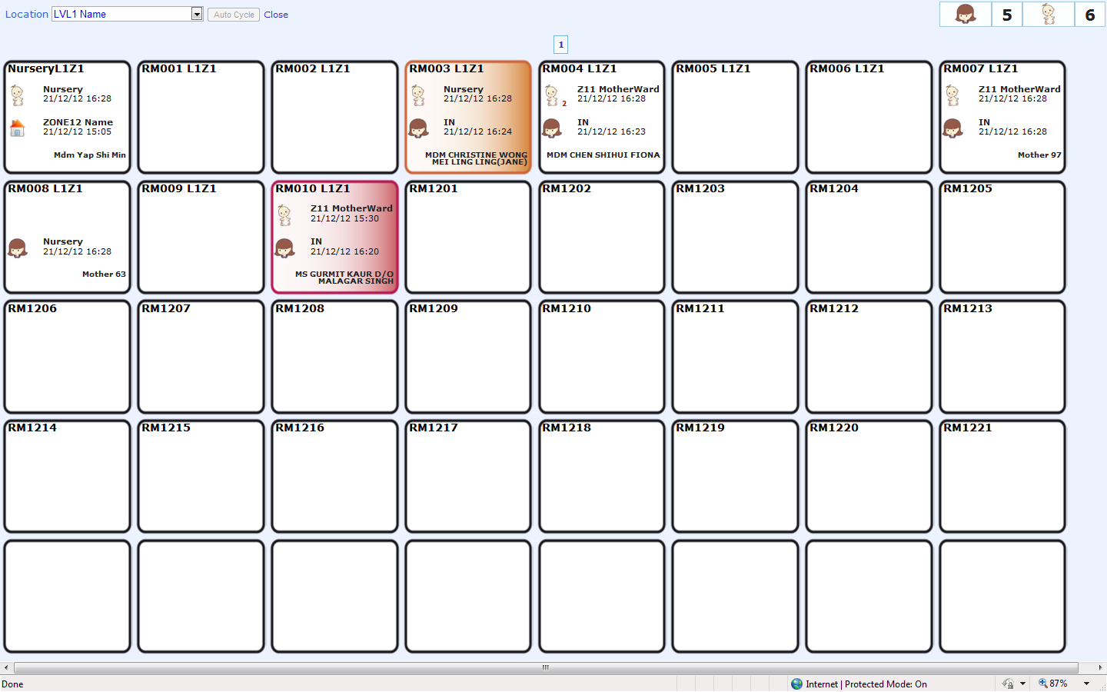
User friendly Dashboard:
Notes:
This system comes with a user friendly dashboard that shows both mother and infant pair on a patient tile. The real time alert will be shown in orange or red depending on the priority.

Slide 10
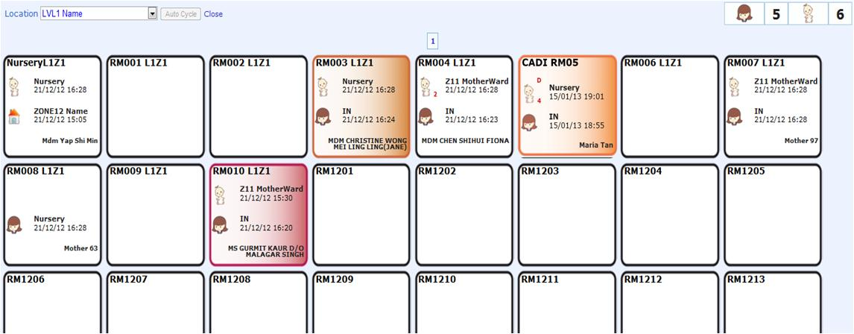
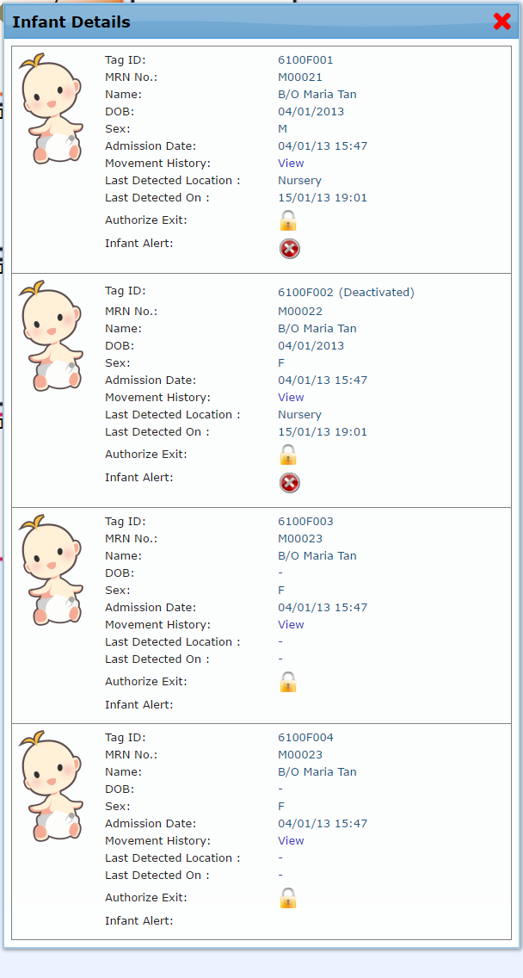
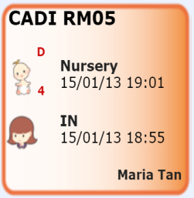
User friendly Dashboard:
Notes:
, To know more about the alert, simply click on the tile.

Slide 11
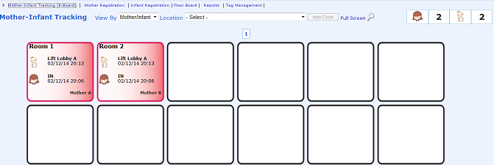
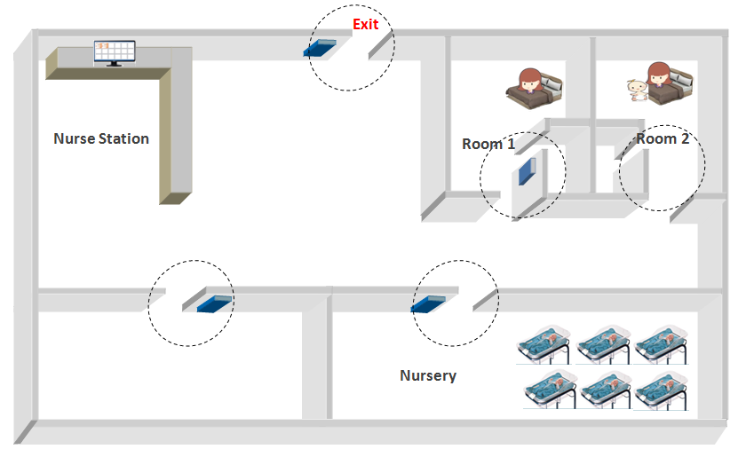


Unauthorized Exit Alert
Loitering standby
Lock a door
Sound a beacon

Slide 12
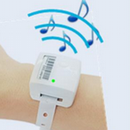
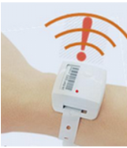
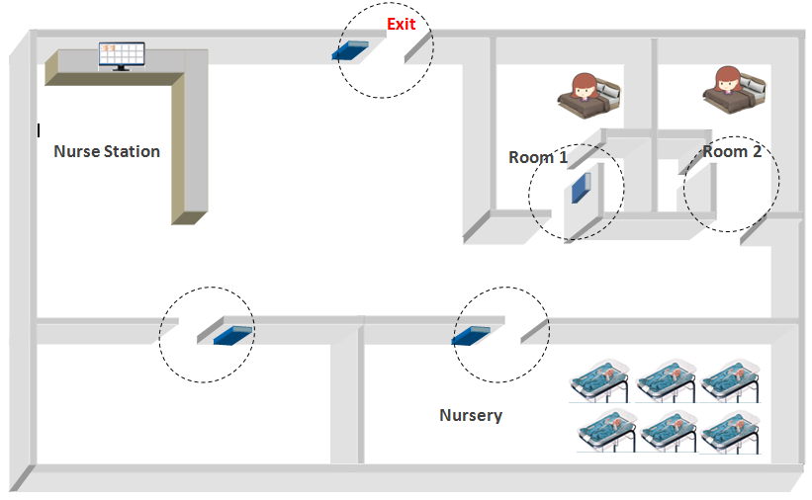
Mismatched Alert !

Slide 13
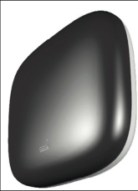
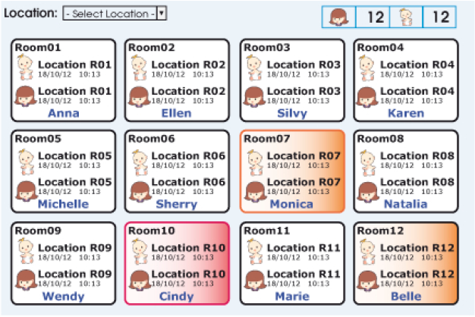
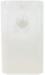
What does it comprise of?
Prevent mismatch
Detect loose strap
& tamper
Detected at Unauthorized exits, loose strap & tamper
Infant straps
Receivers
Software Dashboards
Exciters
CADI SCIENTIFIC
CONFIDENTIAL
13

Slide 14
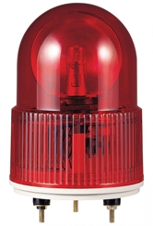
Sample Hardware Deliverables
Light Beacons
Receiver with accessories
Exciter with accessories
mother-infant-cot tags
+ multiple births tags
+ storage trays
safety bands
CADI SCIENTIFIC
CONFIDENTIAL
14

Slide 15

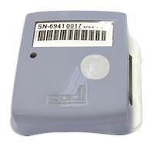
Network Architecture
2 units of SmartSense Servers
CPU: 2 x 8 core
Memory: 32 GB
Hardisk: 2 x 600GB 15krpm SAS RAID1
2 x quad-port 1G NIC
2 x dual-port 16G FC
VMware license: 2 x VMware vSphere Enterprise Plus for 1 processor
Microsoft license: Microsoft windows license for 16 core and 6 VMs, Microsoft SQL license for 4 vCPU
Veritas NetBackup license: 1 x Enterprise Client Tier 2
SmartNode-890s
RF Receiver
SmartNode-826
Door Mounted Receiver
IR
RF
Interface to magnetic lock
Infant Tag
Mother Tag
Cot Tag
LF
CADI SCIENTIFIC
CONFIDENTIAL
15

